Slide 1




SHRI RAM INSTITUTE OF TECHNOLOGY JABALPUR(M.P.) Department of Computer Science and Engineering
Project Name : Customer Segmentation
Team Leader : Raja Shoaib
Submitted to : Prof. Apoorv Khare
TEAM MEMBERS:
Swechchha Agrawal (0205CS211112)
Vanshika Yadav (0205CS211117)
Raja Shoaib (0205CS223D07)

Slide 2
PROBLEM STATEMENT
Customer Segmentation is a popular application of unsupervised learning. Using clustering, identify segments of customers to target the potential user base.
They divided customers into Group groups according to common characteristics like gender, age, interests and spending habits so they can market to each group effectively.
Use K-means clustering and also visualize the gender and age distributions. Then analyze their actual incomes.

Slide 3
What it is doing?
Task
For example, group of customers have high income but their spending score(amount spent in the mall) is low so from the analysis we can covert such type of customers into potential customers(whose spending score is high)by using strategies like better advertising, accepting feedback and improving the quality of products.

Slide 4
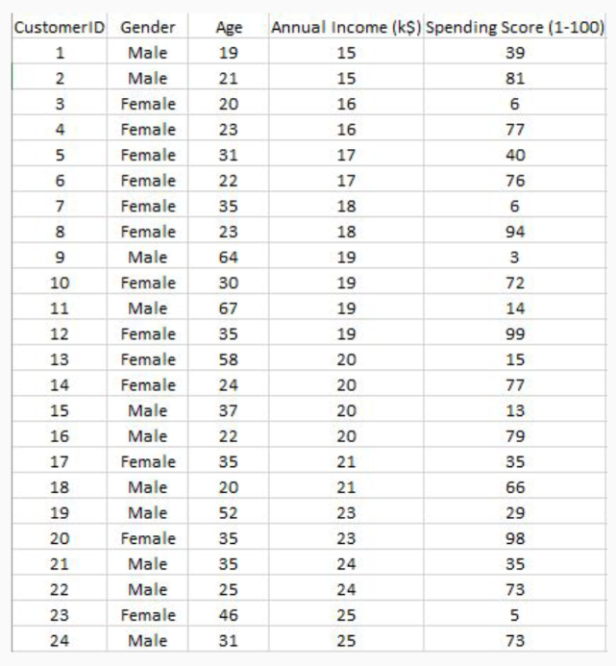
OVERVIEW of DATASET
The dataset name is Customer.csv consists of 5 columns which are customer ID, Gender, age, Annual income(k$), spending score(1-100) where gender is a categorical value and rest all features are numeric.
The size of the dataset is (200,5) which is 200 rows and 5 columns.

Slide 5
MATHODOLOGY
DATA : The size of the dataset is (200,5) which is 200 rows and 5 columns. Also on dataset does not contain any NULL or Nan values.
ALGORITHUMS : K-means algorithm is used in this project to analyse and form clusters of customers based on their income and spending score features.
PROGRAMMING LANGUAGE : Python
ENVIRONMENTAL(libraries and technologies) : NumPy, Pandas , Matplotlib ,Seaborn, Jupyter Notebook, Google Colab,

Slide 6
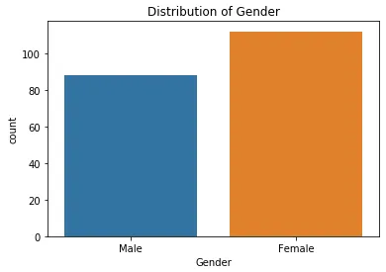
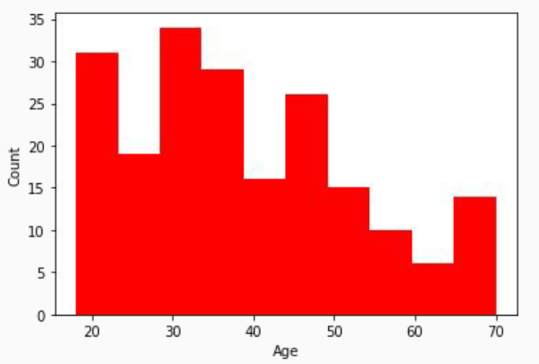
IMPLEMENTATION
Gender Plot :
From the count plot, it is observed that the number of female customers is more than the total number of male customers.
Age Plot :
From the histogram it is evident that there are 3 age groups. They are :
15-22 year , 30-40 year , 45-50 year.

Slide 7
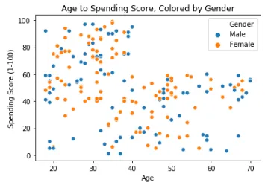
Age Vs Spending Score:
Age Vs Spending Score Analysis
From the age Vs Spending Score plot we observe that customers whose spending score is more than 65 have their Age in the range of 15-42 years. Also from the scatter plot it is observed that customers whore spending score is more than 65 consists of more Females than Males.
The customers having average spending score i.e: in the range of 40-60 consists of the age group of the range 15-75 years and the count of males and females in this age group is also approximately the same.

Slide 8
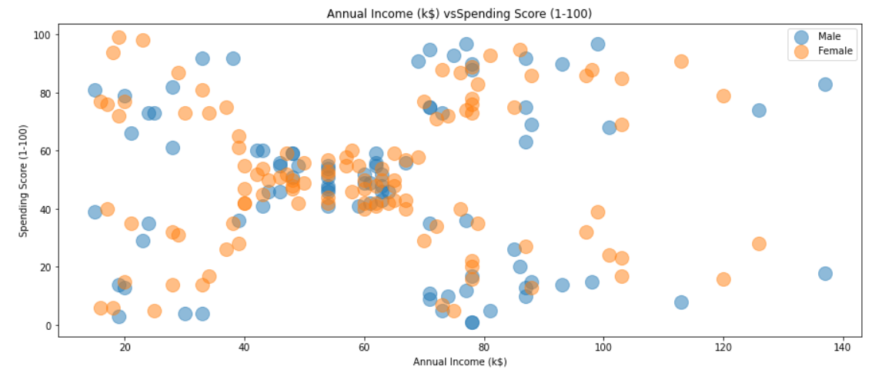
Annual Income Vs Spending Score:
Annual Income Vs Spending Score Analysis
We observed that are 5 clusters and can be categorized as:
High Income, High Spending Score (Top Right Cluster)
High Income, Low Spending Score (Bottom Right Cluster)
Average Income, Average Spending Score (Center Cluster)
Low Income, High Spending Score (Top Left Cluster)
Low Income, Low Spending Score (Bottom Left Cluster)

Slide 9
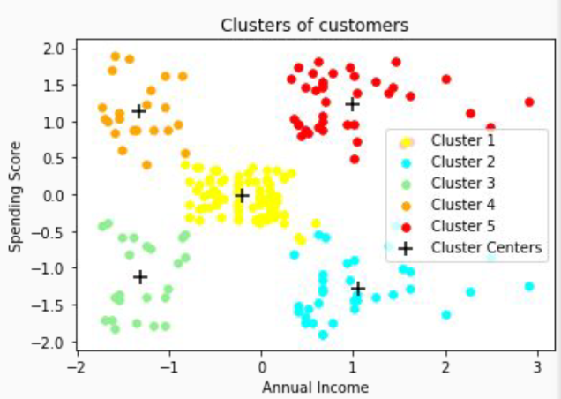
Clustering Analysis:
﻿a. High Income, High Spending Score (Cluster 5) - Target these customers by sending new product alerts which would lead to an increase in the revenue collected by the mall as they are loyal customers.
b. High Income, Low Spending Score (Cluster 2) - Target these customers by asking the feedback and advertising the product in a better way to convert them into Cluster 5 customers.
c. Average Income, Average Spending Score (Cluster 1) - May or may not target these groups of customers based on the policy of the mall.
d. Low Income, High Spending Score (Cluster 4) - Can target these set of customers by providing them with Low-cost EMI's, etc.
e. Low Income, Low Spending Score (Cluster 3) - Don't target these customers since they have less income and need to save money.

Slide 10
ADVANTAGES
DEMOGRAPHIC SEGMENTATION : This segmentation divides the customer market based on gender, age etc.
This segmentation divides the customer market based on COUNTRY, STATE,CITY and locality.
BEHAVIORAL SEGMENTATION : this kind of segmentation divides the customer market on the basis of actions, spending habits, and how they consume.
Better Customer Relationship.
Best economies of Scale.
Improve Channel of Distribution.

Slide 11
Future Scope
Healthcare and Personalization: In healthcare, machine learning can segment patients based on their medical history, lifestyle factors, and genetic information to personalize treatment plans and interventions, leading to better health outcomes.
Fraud Detection and Risk Management: Customer segmentation can aid in identifying fraudulent activities by spotting anomalies in behavior or transactions. By analyzing patterns in legitimate and fraudulent behavior, machine learning models can help businesses detect and prevent fraud more effectively.
Customer Service Optimization: Machine learning can analyze customer interactions across various channels (such as email, chat, or social media) to identify common issues or pain points. Businesses can use this information to improve customer service processes and address concerns more effectively.
Segment-Specific Pricing Strategies: By segmenting customers based on factors like demographics, purchasing power, and behavior, businesses can develop pricing strategies tailored to each segment. This can maximize revenue while maintaining competitiveness in the market.
Market Basket Analysis: Machine learning algorithms can analyze transaction data to identify patterns in purchasing behavior, such as which products are frequently bought together. This information can be used to optimize product placement, cross-selling, and upselling strategies.

Slide 12
Thank you

